Slide 1
Project 4: Electrostatics
Elias Rilegård • 2022-12-14

Slide 2
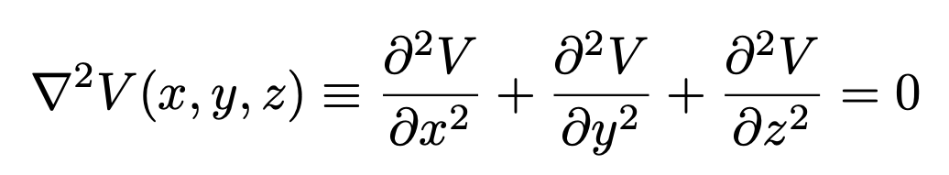
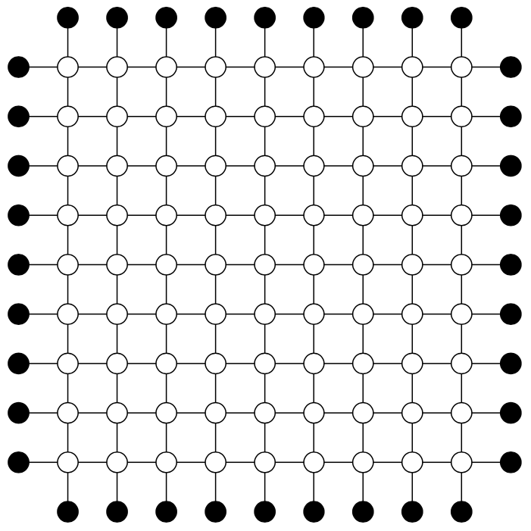
4.1: Laplace’s Equation
Simulating the potential in a square region

Slide 3
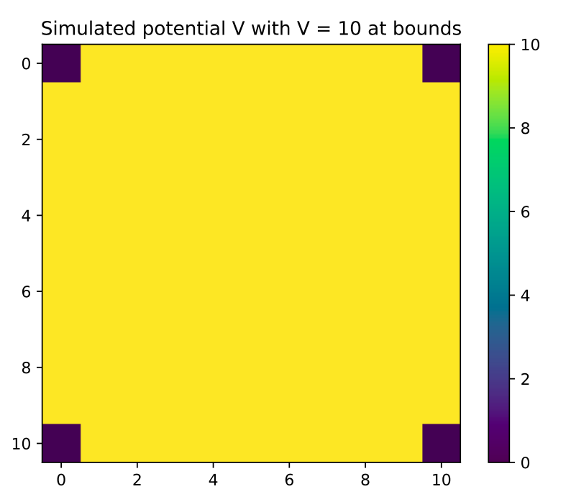
Part a)
V = 10 at boundaries
Approximate V(x,y) as a function of its neighbors
Initialize V(x,y) to 90% of final value
Homogeneous boundary
No charges
∴ V must be constant

Slide 4
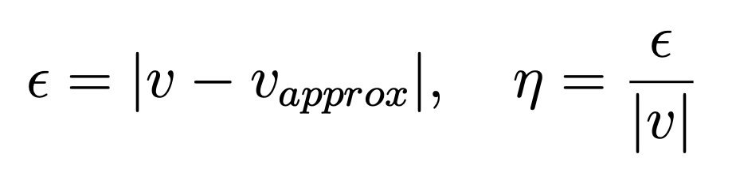
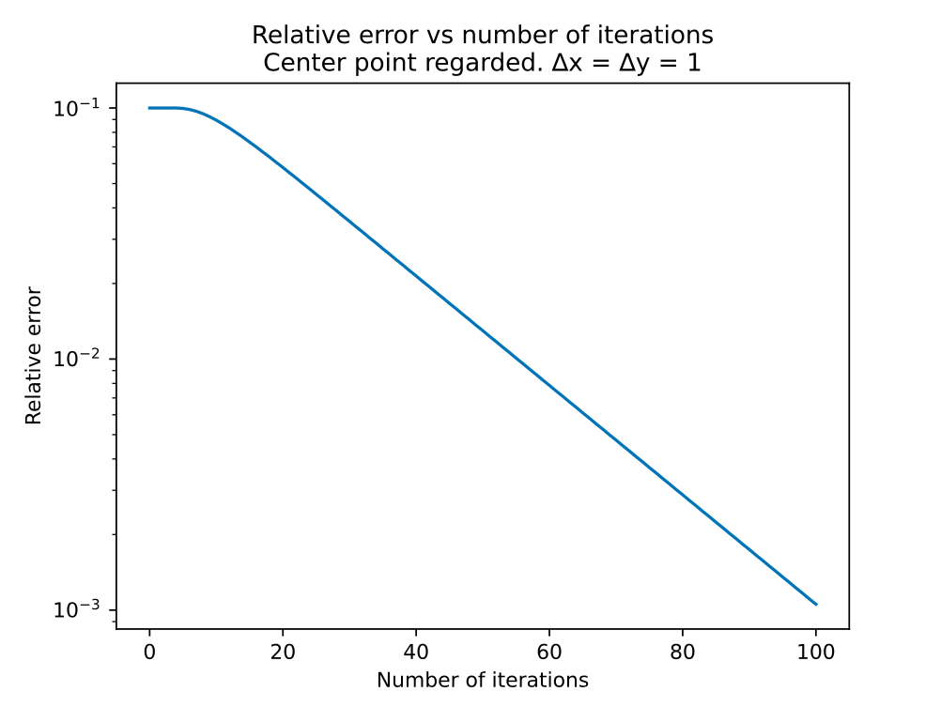

Part a)

Slide 5
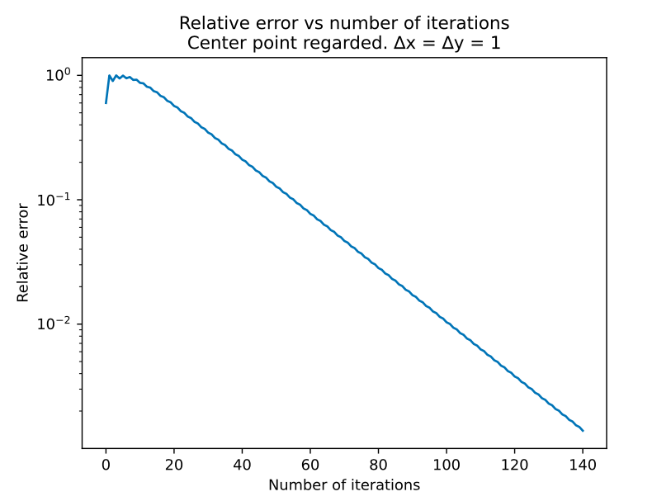
Part b)
V = 0 initially
Except, V(5,5) = 4
Oscillations
Ripple effect
Roughly same slope
N twice as big
Still converges

Slide 6
Part c)
V = [10, 5, 10, 5] at boundaries
V(x,y) initialized to 7.5 - average of boundary values
Simulation of the potential
Equipotential surfaces

Slide 7
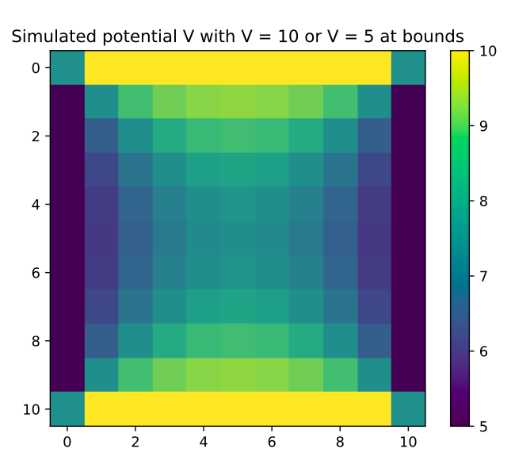
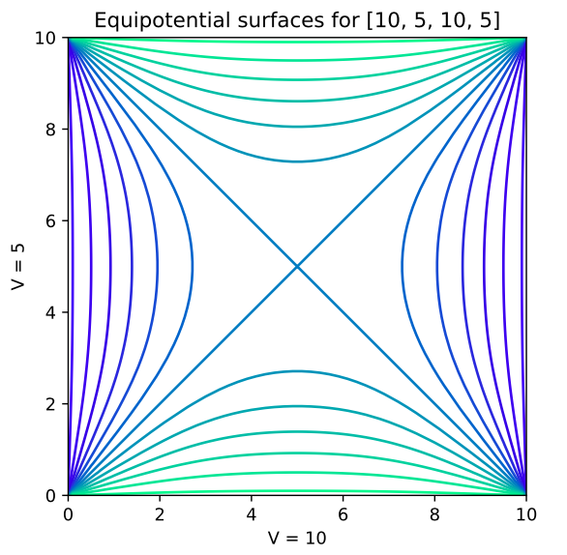
Part c)
Notes:
Remember this distribution, it’s used later.

Slide 8
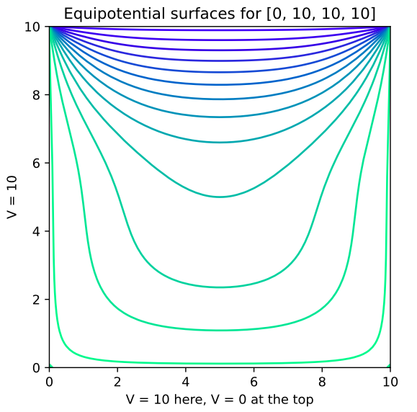
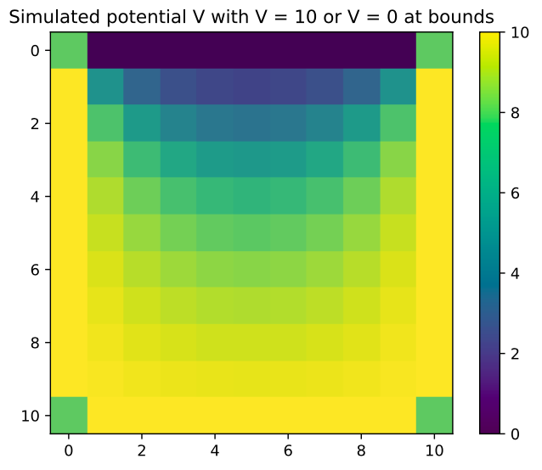
Part c)

Slide 9
4.2: Gauss-Seidel Relaxation
Each spot is updated as soon as it’s calculated
Less/No propagation time
A (computationally) simpler algorithm

Slide 10
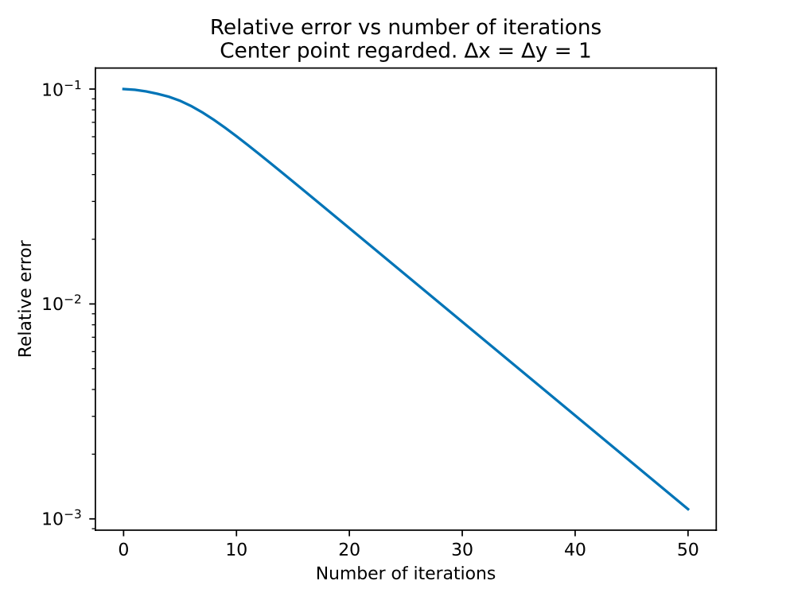
Part a)
Instant decrease
29 iterations for η = 1%
Scale of N roughly cut in half
Essentially no propagation time

Slide 11
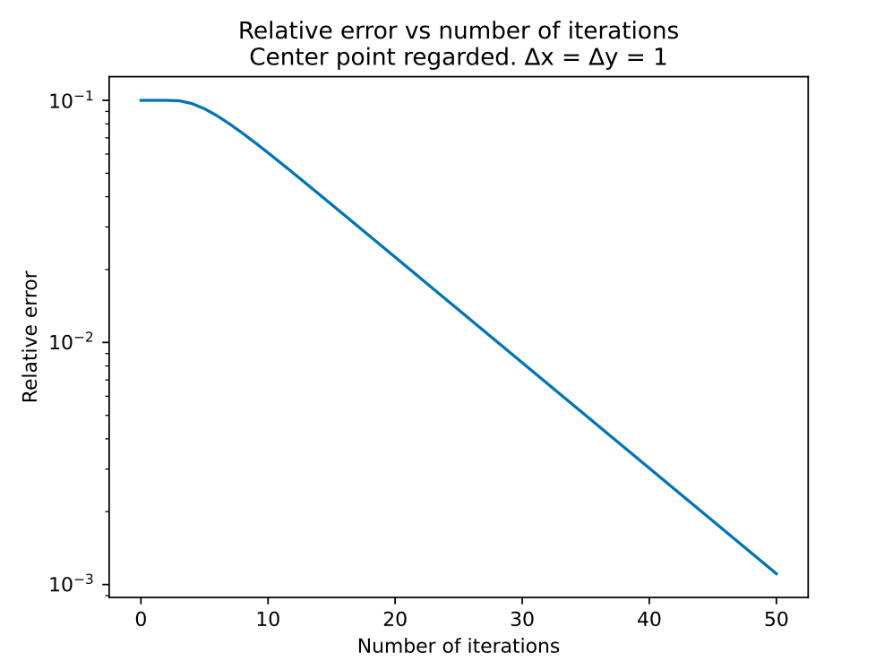
Part b)
Checkerboard update pattern
29 iterations for η = 1%
Some propagation time
Not faster but not slower either

Slide 12
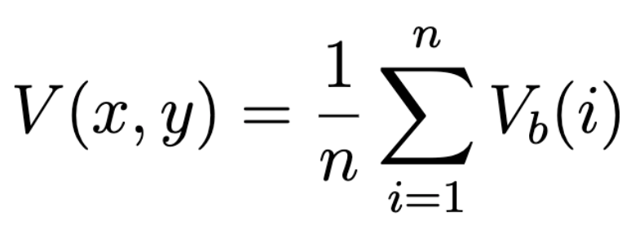
4.3: Random-walk solution of Laplace’s Equation
Same [10, 5, 10, 5] boundary geometry
Random walks originating from (x,y)
A non-deterministic approach

Slide 13
Part a)
(x,y) = (5,5)
Random walk until a boundary is detected
Record potential at boundary
Estimate potential by averaging for many walks

Slide 14
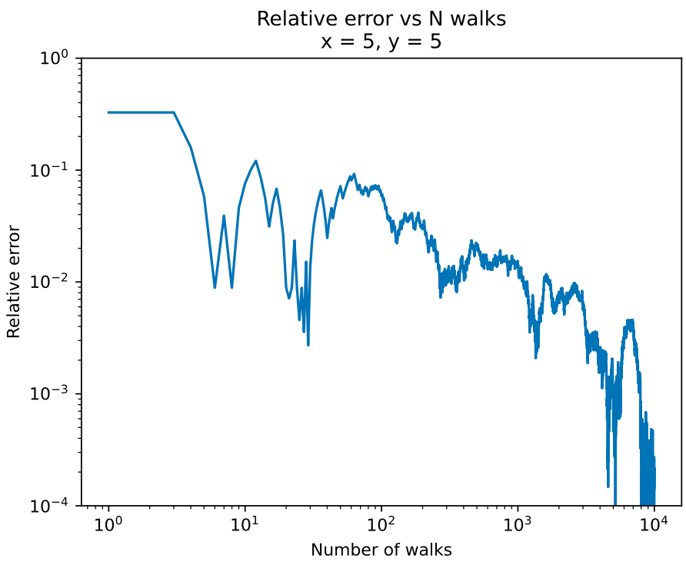
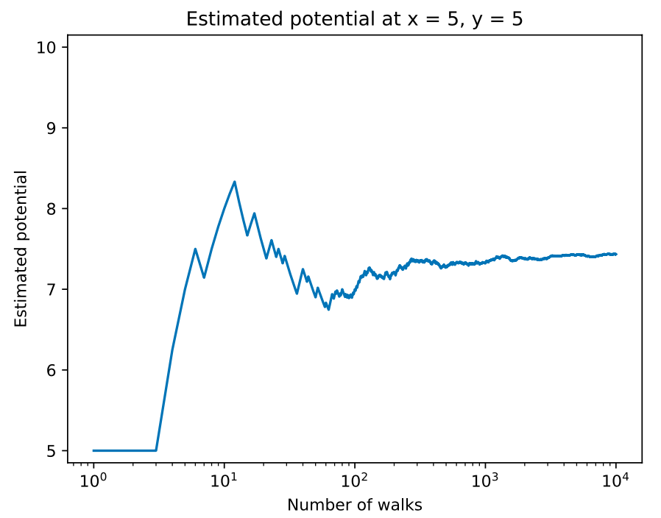
Part a)

Slide 15
Part b)
(x,y) = (2,5) and (1,1)
More or less near boundary?
Error vs N: Rate of convergence

Slide 16
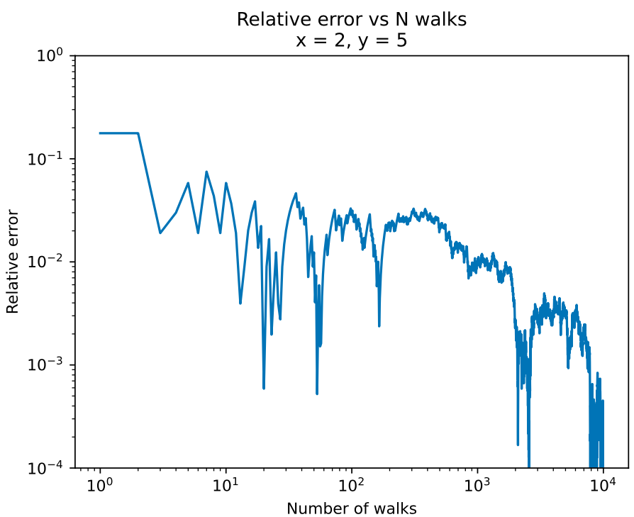
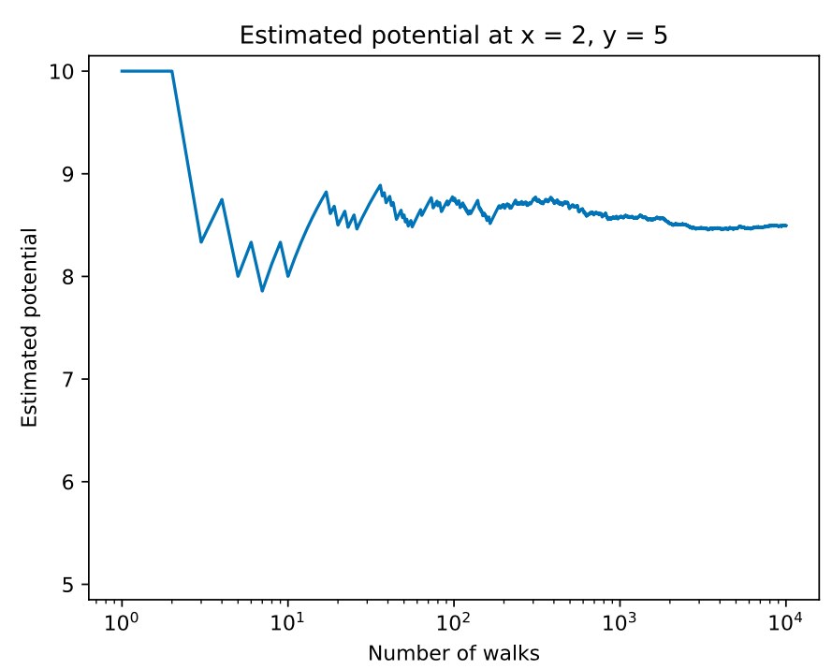
Part b)

Slide 17
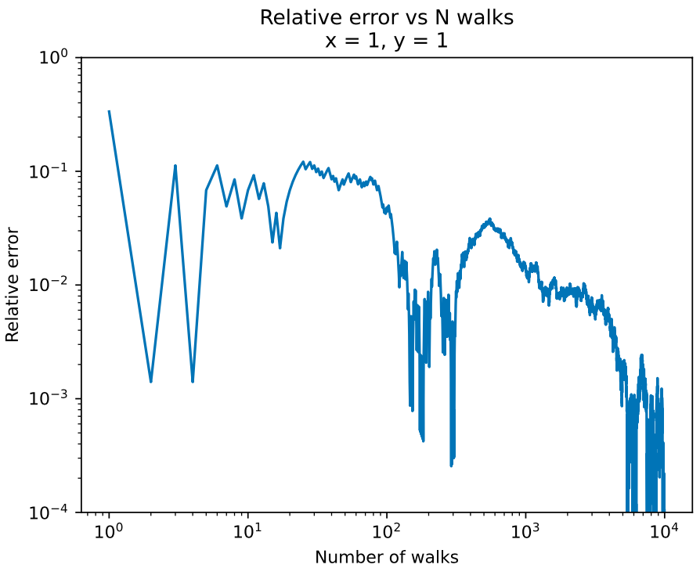
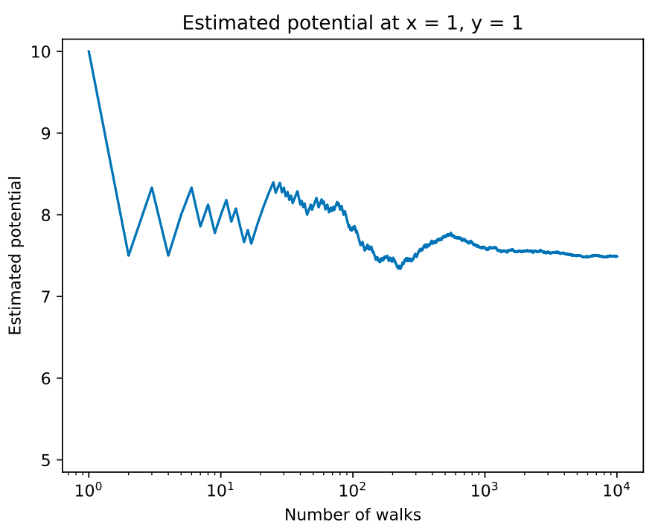
Part b)

Slide 18
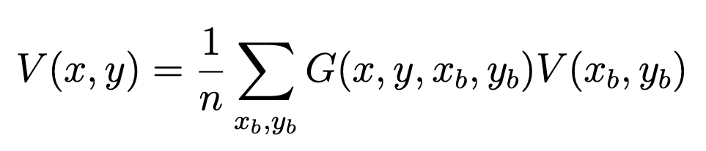
4.4: Green’s Functions
G(x,y,x_{b},y_{b})
Distribution of how boundaries at (x_{b},y_{b}) affects (x,y)
Can be used for different boundary potentials for the same geometry
Saving repeated computations

Slide 19
Part a)
From every (x,y), start N random walks
Calculate distribution of where they land
Store distribution with key (x,y)
Assignment suggested N ≥ 200
Geometry small enough ⇒ N = 10,000

Slide 20
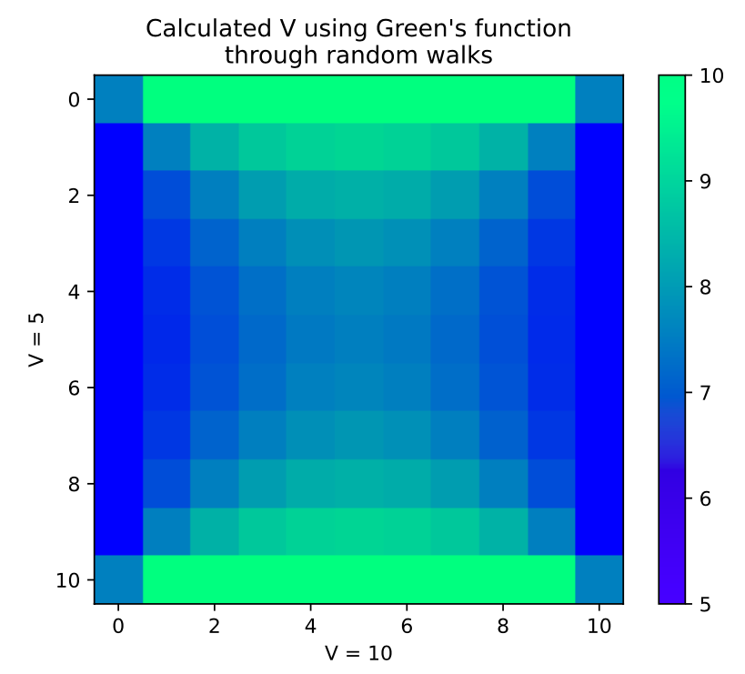
Part a)
Recalculate the [10,5,10,5] case
Corners modified for contrast and clarity
We get the same distribution
∴ Algorithm works

Slide 21
Part b)
Same [10,5,10,5] distribution, but five points has V = 20
Where should these points be placed to maximize V at (3,5) and (5,3) respectively?
Biggest influence in G
(x_{b},y_{b}) where G(3,5,x_{b},y_{b}) is biggest: line at boundary closest to (3,5)

Slide 22
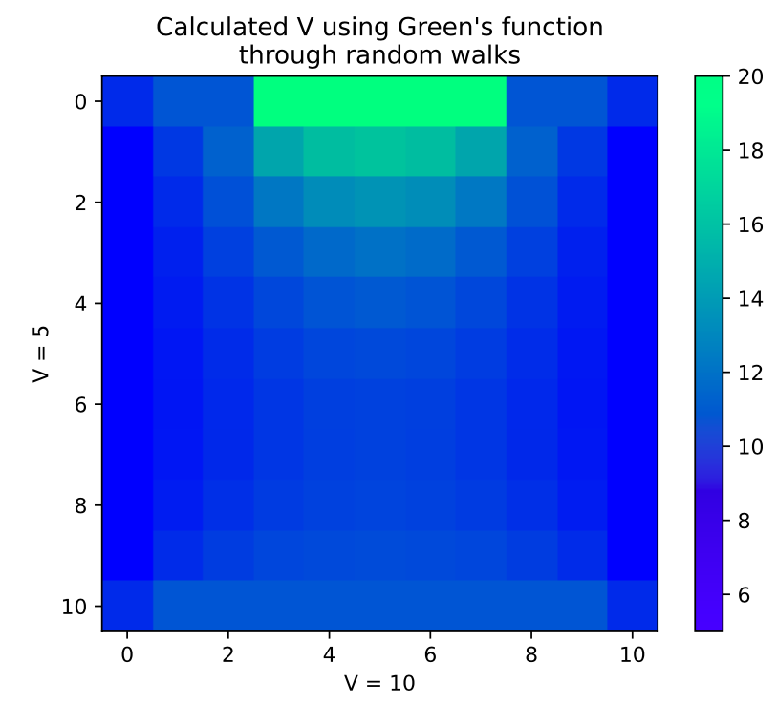
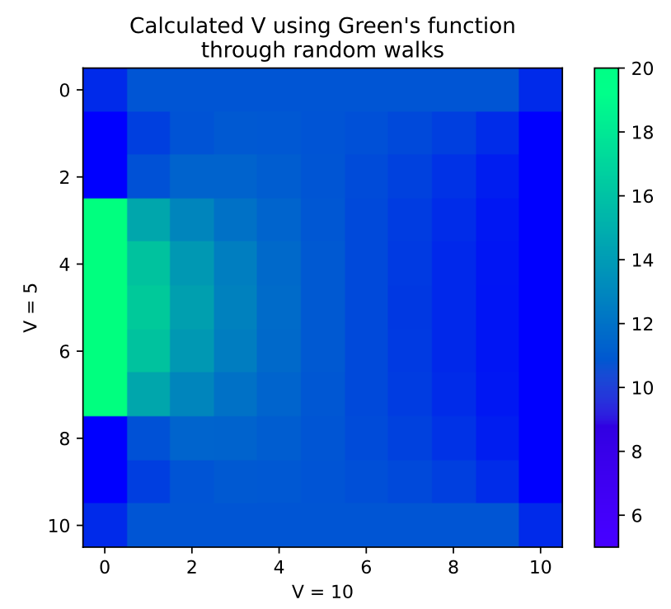
Part b)
V(5,3) = 11.64
V(3,5) = 12.61
Notes:
In the code, these coordinates are actually swapped (as a consequence of the data structure), but for ease of understanding I’ve reversed them here.

Slide 23
Thank you!
Any questions?

